Slide 1
03 - Pandas
Machine Learning

Slide 2
Course Overview:
1.1 - Python Review
1.2 - Numpy
1.3 - Pandas
1.4 - Seaborn
2.1 - ML Intro
2.2 - Linear Regression
2.3 - Logistic Regression
2.4 -Naïve Bayes Classifier
2.5 - KNN
2.6 - Decision Trees
3.1 – Ensembling Learning
3.2 - Neural Networks
4.* - Natural Language Processing (NLP)
5.* Competition Tips & Final Thoughts

Slide 3
Intro - What is Pandas?
01
Installation
02
TABLE OF CONTENTS
Series and Dataframes
03

Slide 4
01
What is Pandas?

Slide 5
Pandas
Python library closely related to NumPy, both go hand in hand
Used for manipulating and storing data
E.g. cleaning, transforming, analyzing, etc.
Very similar to excel, but has a lot more features and flexibility

Slide 6
02
Installation

Slide 7
Installation
In Command Prompt:
> conda install pandas ---OR--- > pip install pandas
Importing in Python:
import numpy as np # we always need numpy! import pandas as pd # this imports pandas!

Slide 8
03
Series and Dataframes
You can enter here the subtitle if you need it

Slide 9
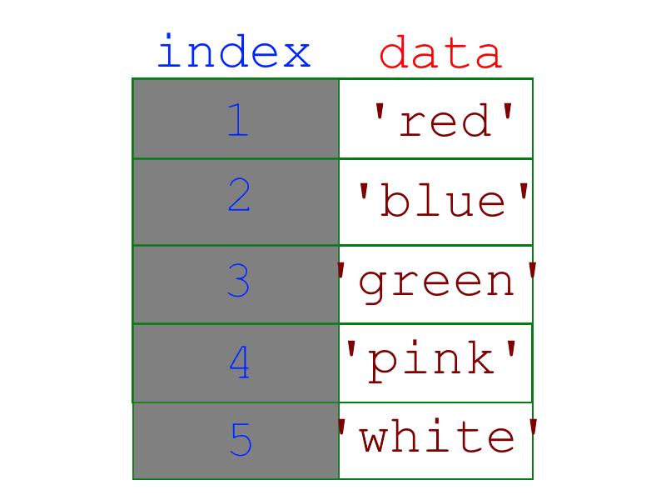
Series
Stores 1-dimensional data - very similar to NumPy arrays
Every series has indexes and data
Indexes are more flexible than NumPy, aren’t limited to numbers
The data can be anything - numbers, strings, dates, etc.
Not limited to one type of data

Slide 10
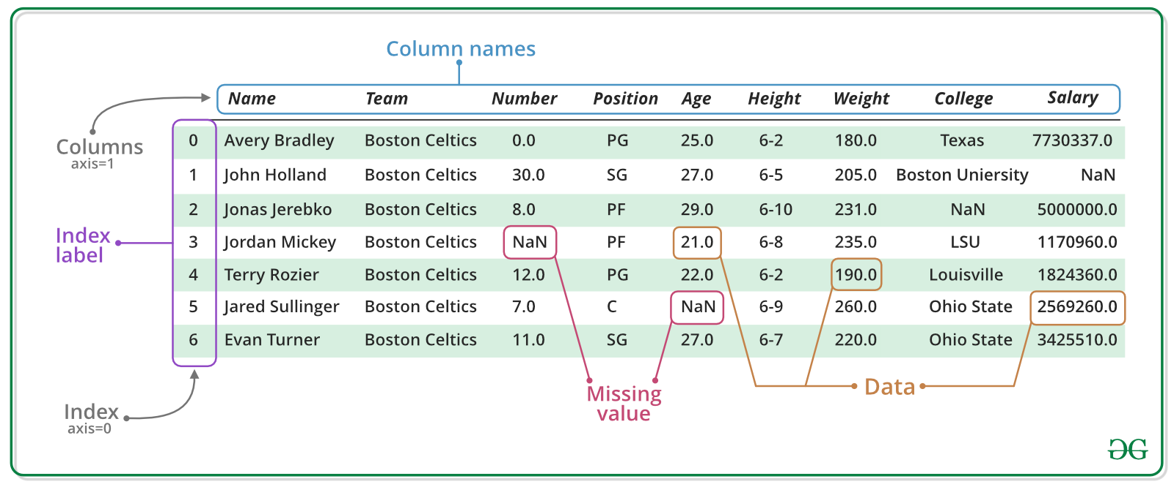
DataFrames
A collection of series

Slide 11
Important dataframe methods
df.head() gives quick snapshot of data (first 5 rows)
You can specify more rows by passing in parameter
df.info() provides important details of dataset - # of rows/columns, null values, type of data in each column, etc.
df.shape() outputs the dimensions of dataframe in a tuple (# of rows, # of columns)

Slide 12
Accession
Accession
df[‘column_name’] returns the specific column in the form of a pandas Series
.iloc + .loc
df[df[‘column’]==___]
Making a new column

Slide 13
.apply
Apply
Write out a function
Lambda notation
Example: to split a certain string apart and create a new column
Df[“newcolumn”] = df[“oldcolumn”].apply(lambda x: x.split(‘:’)[0])
What this does is pick out the first word before the colon

Slide 14
Null values
When dealing with missing data, either drop of fill missing values
Drop: df.dropna()
Make sure to specify axis=1 if wanting to drop columns
Thresh argument can be used to specifically drop only columns with less than a certain amount of missing data points
Fill: df.fillna(#whatever)

Slide 15
All about Null values
First to count the amount of null values:
df.isnull() - returns a dataframe with true and false values
To get the count per column, do df.is_null().count()

Slide 16
Thank you!

